Slide 1
Assignment 6

Slide 2
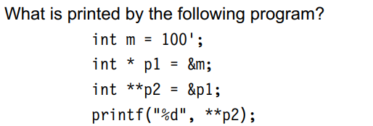
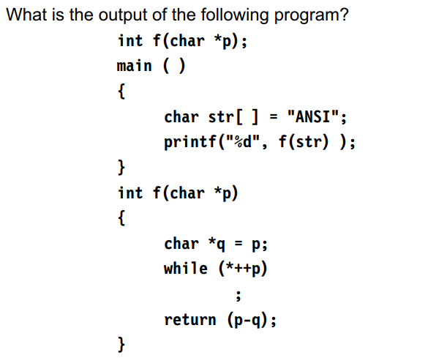
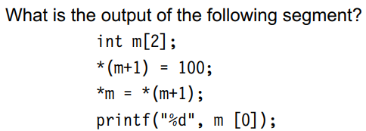

Slide 3
Write a program to read n elements to an array and print those elements using pointer to an array
Write a program to read an employee number ,name, age ,salary and print details using structure
Repeat the above pgm and show dob with day, month and year of employee with nested structure.
4. Write a program to find sum of 2 numbers using structure
5. Write a program to find biggest of 3 numbers using structure
6. Write a program using pointers to compute the sum of all elements stored in an array
7. Write a program using pointers to determine the length of a character string.
8. Write a function using pointers to exchange the values stored in two locations in the memory

Slide 4
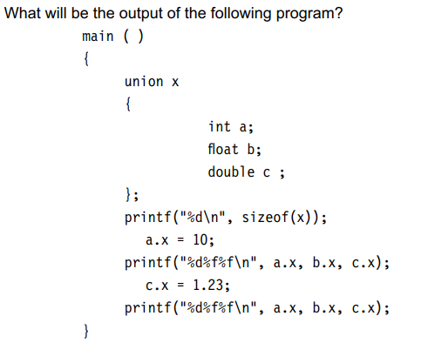

Slide 5
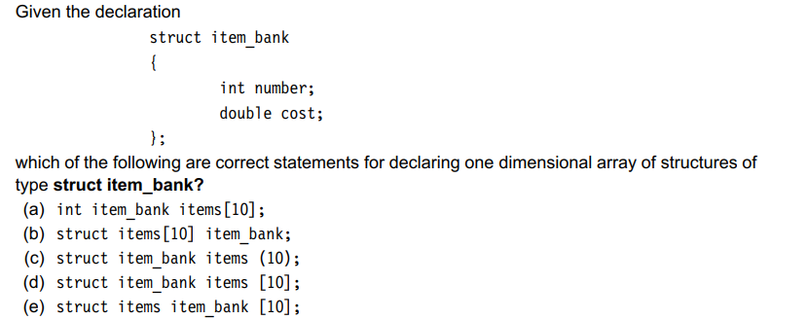

Slide 6
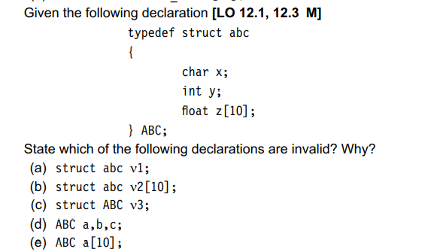

Slide 7
